Slide 1
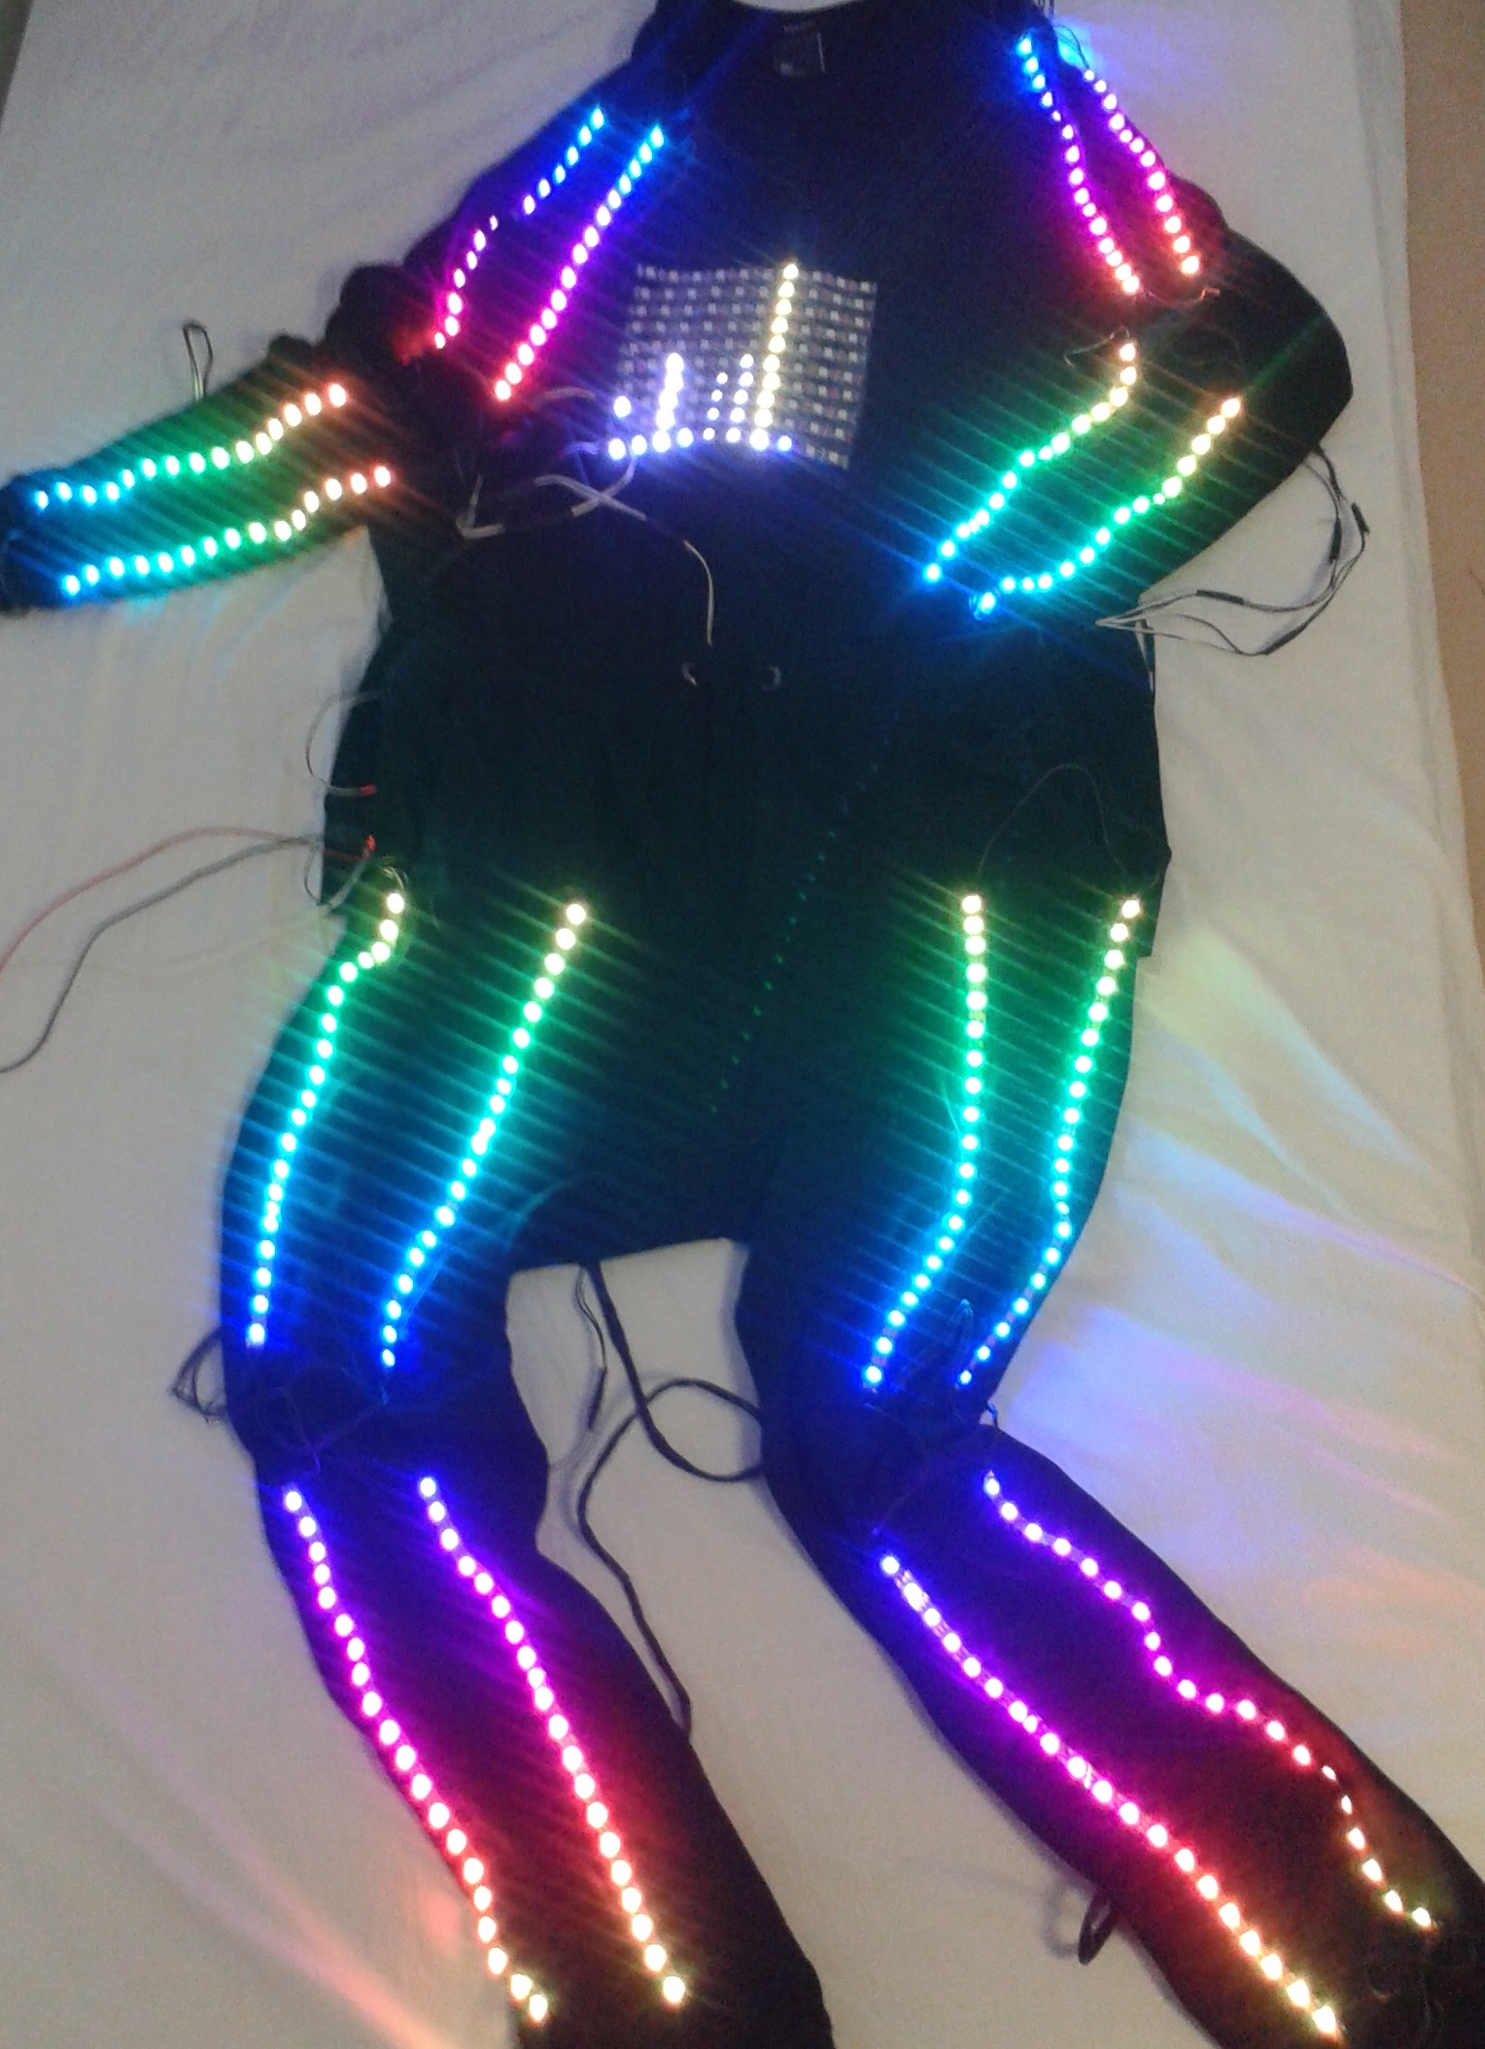
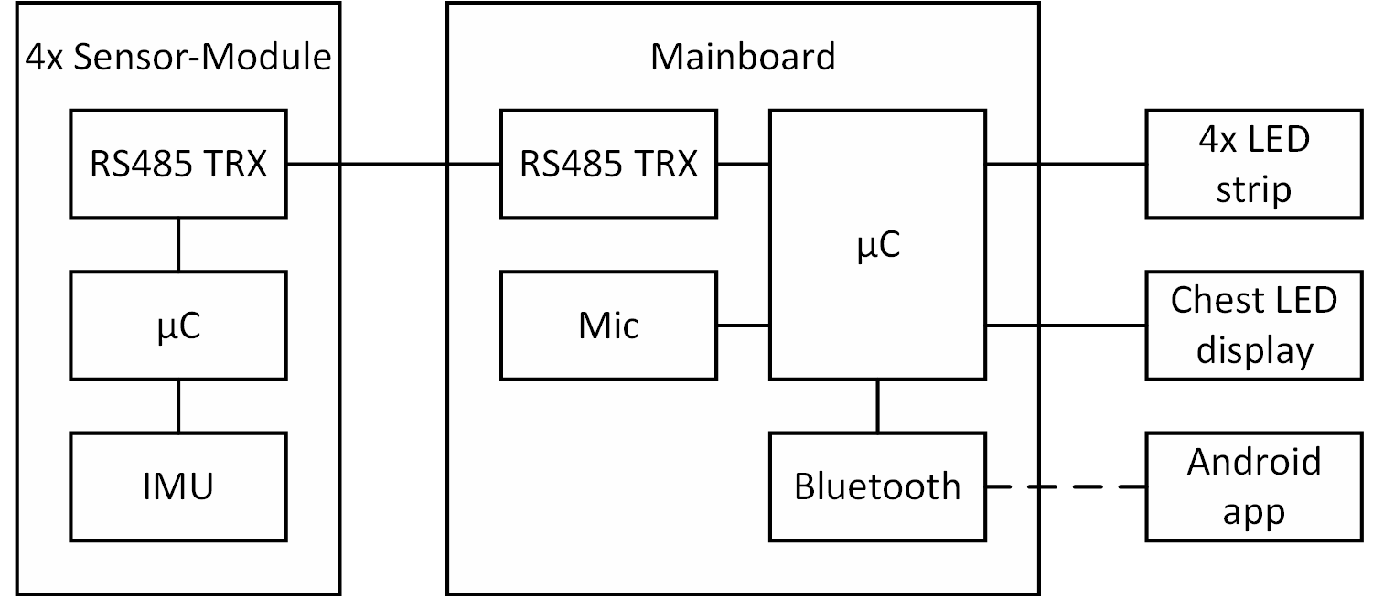
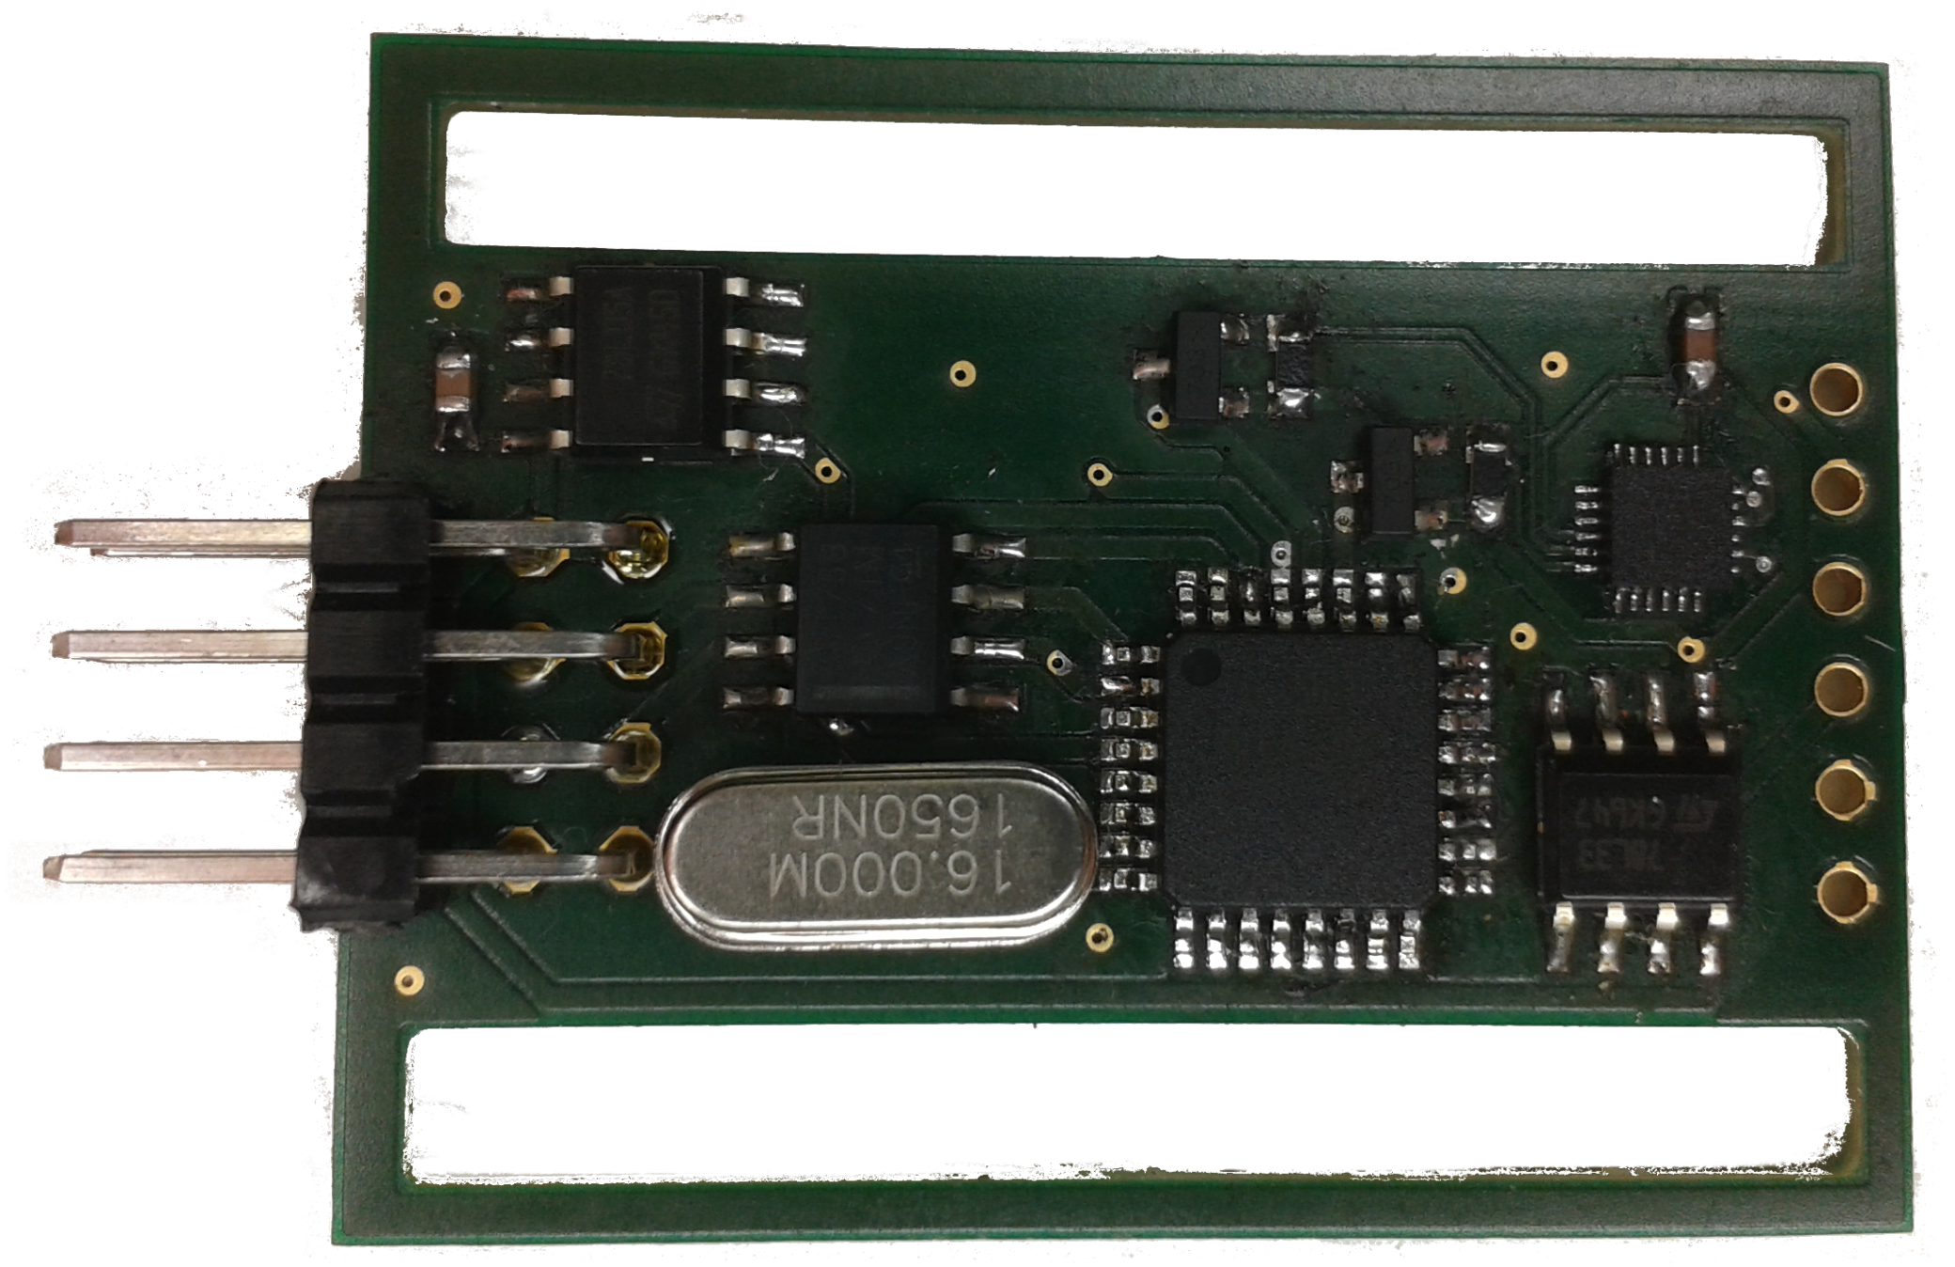
Smart dancing suit
Making music visible
The sound of the environment is measured by a microphone
LEDs react to the environment sound
Intelligent music recognition by applying fourier transform to the sound measurements
Displaying of the music spectrum on chest
Reacting to movements
Body movements are detected by IMUs mounted on hands and feet
The IMUs perform 6-axis sensor fusion
LEDs react to the movements measured by the IMUs
Creating an audiovisual performance
LEDs change their colors and blinking patterns according to the music and the movements of the wearer
Suit behavior can be configured via android app
Generating an LED-choreography on the fly
The hardware
Arduino-compatible custom sensor board hardware
Yaw, pitch, roll and 3-axis acceleration data of each body part gets sent to the mainboard over an RS485 master-slave bus
STM32F4 discovery board with breadboard shield as mainboard
Individually addressable WS2812 RGB LEDs
Sound detection with adafruit MAX9814 microphone module
Communication with an android app via bluetooth
Bluetooth module uses UART interface to communication with the microcontroller
Android app
User can selecet features for body parts
colors of the LED
colors for the colorfade function
turn on the spectrum
Choose the blinking pattern of the suit: Alwasy On, Stroboscope, Motion Detection
Design of the app menus
Schematc setup of the system
Sensor board

